Slide 1
Streaming and Real Time Analytics
INFO7390 17973 Advances Data Sci/Architecture SEC 02 - Fall 2017
Team Members :
Jaini Bhansali
Tushar Goel

Slide 2
Introduction
Streaming and Real Time Analytics: To analyze and performs actions on real-time data though the use of continuous queries. It is achieved by connecting to external data sources, enabling applications to integrate certain data into the application flow, or to update an external database with processed information
This has become more achievable and is facilitated by various platforms like Apache Spark , Hadoop , Apache Flint, Apache Storm , Trident just to name a few…
From the various options available we have used Apache Kafke and Pyspark

Slide 3
Apache Kafka
Apache Kafka is a distributed, high-throughput message queuing system designed for making streaming data available to multiple data consumers
Kafka makes the streaming data durable by persisting incoming messages
This allows various downstream consumers to read the stream at different positions and different speeds and also read messages from the past
A Topic is the most important abstraction in Kafka
A topic differentiates logical streams of data which might have multiple Partitions
A topic that puts data into a topic is a Producer
A service that reads data from a topic is called a Consumer
Notes:
We should be able to replace IBM’s CIK and document accession number with Googles to generate the url

Slide 4
Salient Features of Apache Kafka
Partitions are logical subsets of data served by the topic that reside on physical nodes
The individual partitions are maned by a ‘Broker’
Broker : A service installed on the node that contains the partition and facilitates producers and consumers to access data of the topic
Each message within the partition is assigned a unique and increasingly logical time stamp within a partition
This offset allows consumers to request messages from a certain offset onwards, essentially consuming data from a given past logical time
If there are multiple consumers then there are consumer groups .
For each consumer group, messages are guaranteed to be consumed at least once.

Slide 5
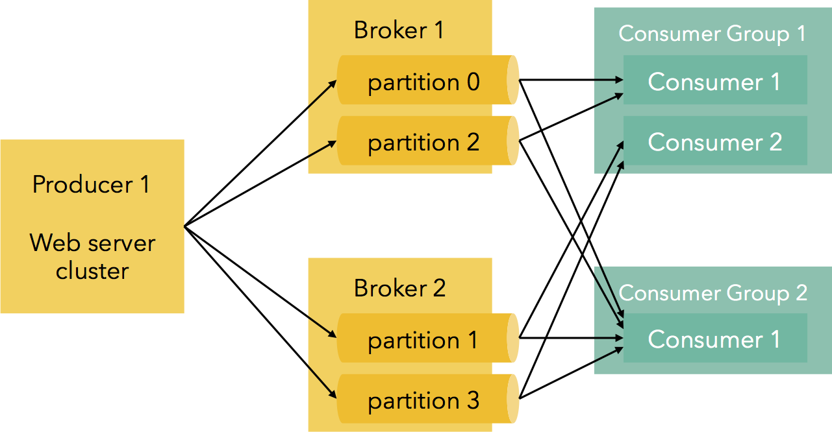
A visual representation of Apache Kafka

Slide 6
PySpark
Pyspark is the interface that gives access to Spark using the Python Programming Language
Pyspark is an API developed in python for spark programming and writing spark applications in Python style
We used the pyspark interface to connect with Kafka and configure the producer and the consumer
One of the interesting features f pyspark is it facilitates connection with Jupyter Notebooks as well

Slide 7
Our Approach and Steps
Began by installing PySpark
Configured Kafka
A Few Challenges to mention ..
Installing PySpark and Configuring Kafka
Configuring Pyspark locally required adding environment variables
Pyspark requires Java 7
Jupyter Notebooks required additional environment Variables to run Pyspark
Kafka installation was smooth but requires Zoo Keeper to run Kafka
Running a simple produces and messages being delivered to a consumer

Slide 8
METHODOLOGY
We used Twitter as a source to incorporate real time streaming
Our main challenge was to configure ports and route data from Twitter to Kafka
We used Twitter as our producer
Routed the streams of data to Kafka
Used PySpark to receive the data and analyze the data
Analysis : We analyzed the sentiments in the tweet
Logic Incorporated for Sentiment Analysis : Sentiment Analysis using Vader-sentiment library which gives the percentage of positivity and negativity in a text and a compound score.

Slide 9
METHODOLOGY
We passed Accession Key, CIK, Amazon s3 keys , S3 location as arguments by the user
Handled scenarios when CIK and Accession Key are blank or if the values are missing with respective –help option
We have accomadated logging. Logging details can be found in the file name ‘Part2.log’
Exception Handling: To name a few:
a. Incorrect or blank CIK, Accession Number, Amazon Keys or S3 Location
b. Blank year or incorrect year entered by user
c. When stream of data is created to input into a csv
d. When data for the particular 1st day of the month is not present
5. Once missing data is analyzed , summary metrics are calculated and plots are
constructed. We put these into a zip file ( python library zipfile) located in a
Directory created using os.path()
6. Next, using boto3 library we programmatically upload the file into Amazon s3

Slide 10
Apache Flink
Apache Flink is streaming dataflow engine. It can be programmed in Scala and Java (there is an experimental Python API as well)
native streaming engine
A very common use case for Apache Flink™ is stream data movement and analytics. More often than not, the data streams are ingested from Apache Kafka, a system that provides durability for data streams
Typical installations of Flink and Kafka start with event streams being pushed to Kafka, which are then consumed by Flink jobs. These jobs range from simple transformations for data import/export, to more complex applications
high-performance dataflow architecture

Slide 11
Qualitative Characteristics
Streaming Model : Unified Streaming model and Batch processing
API : API is declarative and is high level
Stateful Nature : Stateful Operators aid correctly restore the state in case of a failure . (Only Once)
Latency – It has low latecy levels
Throughput – Beyond a certain number of tupples Flink cannot handle a very high throughput
Advantages of Apache Flink
A true stream processing framework
The use of algorithms in both streaming and batch modes
An aggressive optimization engine
Speedier processing
The ability to run existing MapReduce jobs directly

Slide 12
Apache Storm
Is a technology created by Nathan Marz.
Compared to Flink and Spark, it has a compositional API. Meaning you build up your topology with basic building blocks like sources or operators and they must be tied together in order to create expected topology
Storm is a framework for streaming data in real time. It uses a task parallel, distributed-computing system
Architecture :Storm’s topology is designed as a directed acyclic graph (DAG) with spouts, bolts, and streams used to process data
Bolt : Bolts represent the processing logic unit in Storm. One can utilize bolts to do any kind of processing such as filtering, aggregating, joining, interacting with data stores, talking to external systems etc
Spout : spout will act as a data receiver from external sources and creator of streams for bolts to support the actual processing
Stream :unbounded sequences of tuples where tuple is a unit of data. Stream of tuples flows from spout to bolt(s) or from bolt(s) to other bolt(s)
Integrate Storm with YARN, they have a truly powerful system for real-time analytics, machine learning and continuous monitoring

Slide 13
Biggest Difference from Apache Flink is parallelization
Task parallelism is the parallel execution of the different tasks or logical processes across multiple processors or worker nodes
task parallelism to support parallelization in data stream processing
Makes use of topology to implement task parallelism

Slide 14
Qualitative Characteristics
Streaming Model : It does not have batch capabilities
API : It is a compositional API (with building blocks as spouts, streams and bolts)
Nature of State : The source topology keeps a backup of all tupples generated. After a failure to restore state the source topology is replayed.
Latency : Very low latency
Throughput : Storm can handle high throughput

Slide 15
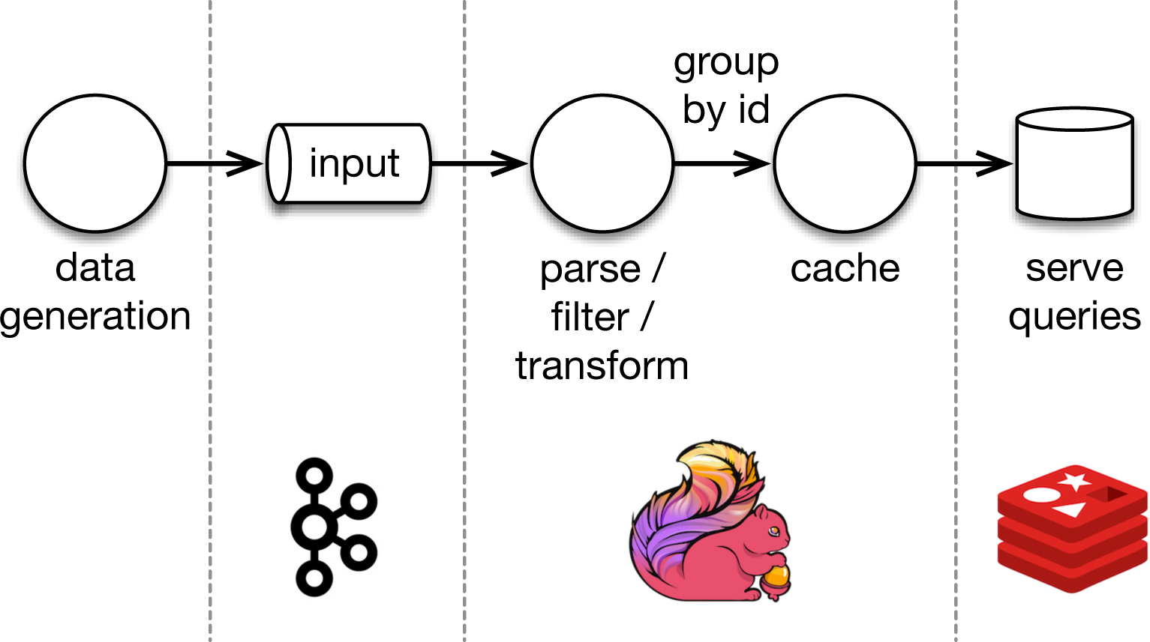
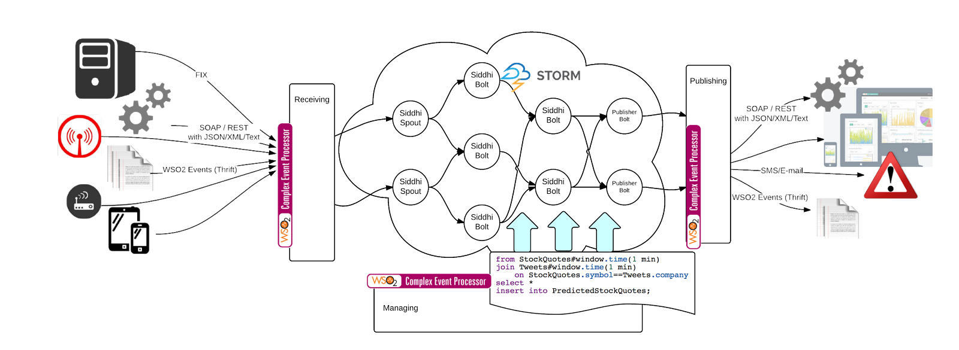

Slide 16


